Slide 1
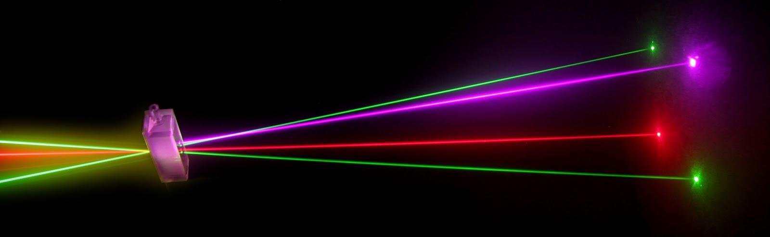
“Laser Technology and Applications” 16B1NPH533 Lecture 23-26

Slide 2
Lecture 23-26 Content Outlines
GENERATION OF HIGH POWER PULSES : Q-Switching
The Q-switching techniques
Mechanical devices: Rotating Mirror
Electro Optic Modulator: KDP crystal, Lithium Niobate crystal
Acousto Optic Modulator: Phase grating
Saturable absorber: Dyes DODCI

Slide 3
GENERATION OF HIGH POWER PULSES
There are two standard techniques for the pulsed operation of a laser
Q-switching
to generate pulses of high energy but nominal pulse widths in the nanosecond regime.
Mode locking
produces ultra short pulses with smaller energy content. It is possible to produce laser pulses in the femtosecond regime..

Slide 4
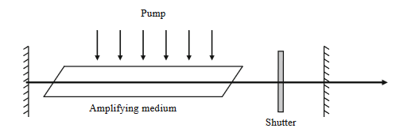
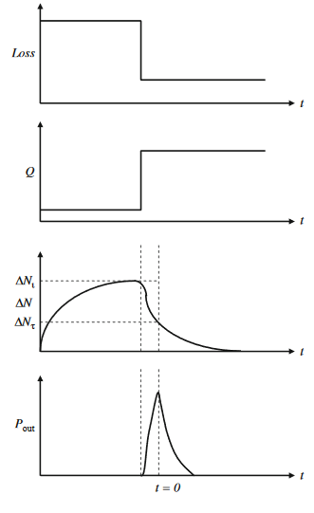
Q-switching
The laser can be prevented from oscillating if, for example, the parallelism of the resonator mirrors is disturbed so that stimulated emission cannot take place.
In the mean time the pumping process can build up the population inversion to a very high value in the medium.
In effect, the Q-factor of resonator is spoiled and optical losses are increased to a high value.
If now the end mirror is aligned suddenly, it reflects photons into the laser medium. The feed back of photons triggers a chain of stimulated emissions and builds up rapidly a photon avalanche. Thus, laser oscillations set in suddenly and the cavity Q is increased abruptly.
All the energy stored in the cavity is emitted in a single giant pulse with peak power much higher than the laser could produce otherwise. The pulse lasts for a short time and depopulates the upper energy level quickly and the lasing action stops. This method of controlling the laser output power is called the Q-switching method. The pulse duration is of the order of 10 −7 to 10 −8 sec.

Slide 5
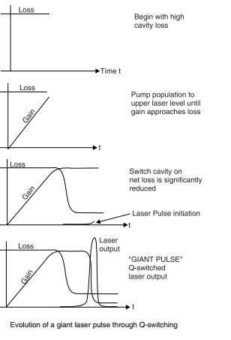
Evolution of a Q-switched laser pulse
To produce the necessary high inversion density required for Q-switching, four requirements must be satisfied.
The lifetime τ_{u} of the upper laser level u must be longer than the cavity buildup time t_{s} , so that the upper level can store the extra energy pumped into it over the extended pumping time:
τ_{u} > t_{s}
2. The pumping flux duration T_{p} must be longer than the cavity buildup time, and preferably at least as long as the upper level lifetime τ_{u} :
T_{p} ≥τ_{u}
The initial cavity losses must be high enough during the pumping duration τ_{u} to prevent beam growth and oscillation from occurring during that time:
[initial cavity losses] > [amplifier gain].
4. The cavity losses must be reduced almost instantaneously, by suddenly introducing a high-g cavity, so that the beam could then evolve and extract the extra energy that had previously built up in the upper laser level u of the gain medium.

Slide 6
Basic Laser Cavity Rate Equations (Quick Revision)
Our goal is to develop an expression for the instantaneous photon number φ within a single laser cavity mode at any given time during the laser process.
We assume that φ is distributed uniformly throughout the laser cavity at any instant during the laser operation. Consider the change in intensity per unit time within the amplifier:
assuming the distributed loss α is small enough to
neglect,
using the fact that only a fraction L/l of the photons are within the gain region and are therefore undergoing amplification at any given time. This suggests that the average intensity change in the cavity can be modified :
Since φ is proportional to the intensity I and hence dφ/dt is proportional to
dl/dt, the rate of change of the number of the photons within the cavity due to the amplifier can now be expressed as

Slide 7
The above equation represents the increase in the number of photons per unit time within the cavity. The decrease in the number of photons per unit time is given by φ/tc which is due to incidental resonator losses and to the output coupling. Therefore, the total change in the number of photons within the cavity is given by
where tc is the effective decay time of the optical cavity typically resulting from losses due to transmission of a portion of the light through the mirrors during each pass through the cavity.
Let us now define a new time variable τ in units of the cavity decay time tc:

Slide 8
Since there is no change in photon number in the cavity with time for a laser operating under steady state conditions,
As γ is proportional to the inversion n,
one out of two principal equation in the evolution of the Q-switched pulse.
where n_{th} =(N2 −N1 ).V is the threshold inversion.
Every time a photon is emitted in the stimulated emission process, n changes by a factor of 2. Since in each transition, an atom leaves upper level and goes to the lower level, the total inversion decreases by 2. As the rate at which population difference is changing must be exactly equal to the rate at which photons are increasing,
second principal equation in the evolution of the Q-switched pulse.

Slide 9
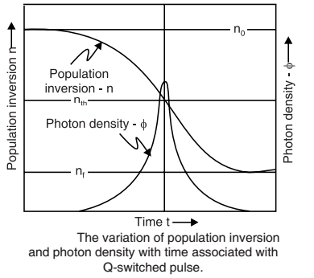
If we assume that there are n_{o} photons initially in the cavity, φ₀ ≅0.
For a time t >> t_{c} , there will also be no photons in the cavity.
φ=0 at t >> t_{c}
where n_{f} is the final value of the population inversion.
The ratio (n₀−n_{f} )/ n₀ is the fraction of energy stored in the population that gets converted to a laser pulse.

Slide 10
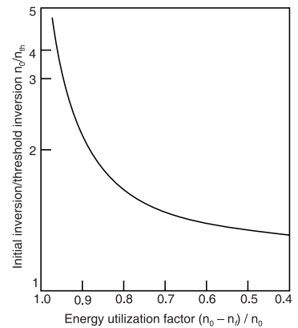
This energy utilization factor tends to unity as n₀/n_{th} increases.
⇒the higher the n_{th} is (before the cavity Q is switched) the more energy will be extracted from the cavity in the form of a giant pulse.
The instantaneous power output of the laser is given by
To find the maximum power,
dP/dn=0
and find that peak power occurs at n =n_{th}. It means that peak power occurs at the beginning of the pulse.
as n_{o}>>n_{th ,}

Slide 11
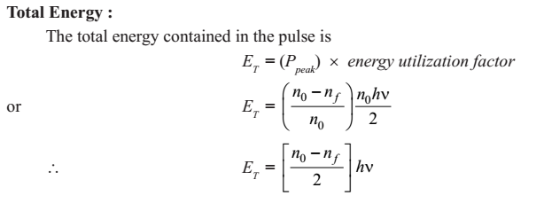
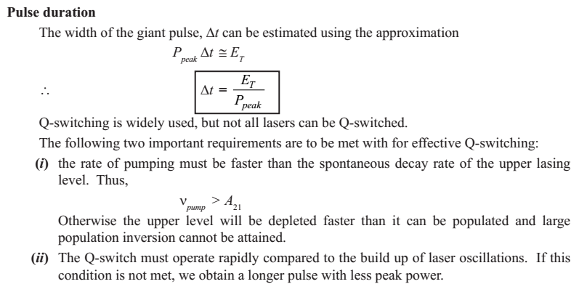

Slide 12
In a given Ruby laser : 3- Level
Length of rod=10 cm ( same a length of cavity)
Area =10 cm²
R1=100% ; R2=70%
No. of Cr⁺³=1.58 ×10¹⁹ /cm³
Wavelength=694.3 nm
Refractive index=1.76
t_{sp}=3 m sec
n_{o}=4n_{th}
Calculate P_{peak},
Energy released,
pulse duration.

Slide 13
Calculate the maximum power output for a Q-Switched Ruby Laser (λ=694.3 nm)
Given that:
chromium concentration= 1.6 ×10²⁵ ions /m³
ruby laser rod= 0.1 m, refractive index=1.75
cavity length = 0.4 m
R₁ = R₂ =90%.
Assume that the radius of the multi-mode laser mode volume within the rod is approximately 1 mm and it is pumped to a factor of 6 times the threshold inversion density.

Slide 14
The Q-switch can take several forms.
Mechanical devices: Rotating Mirror
Electro Optic Modulator: KDP crystal, Lithium Niobate crystal
Acousto Optic Modulator: Phase grating
Saturable absorber: Dyes DODCI

Slide 15
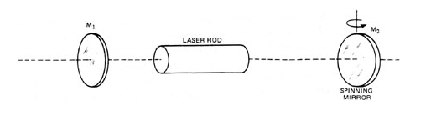
ROTATING MIRRORS
the first method used for Q-switching of a laser.
a rapid rotation of one of the mirrors of the resonant cavity.
The rotating mirror would serve as the rear mirror and an output mirror would be at the other end of the laser cavity. The mirrors come into parallel position for a short interval in each rotation.
When the mirrors are not parallel,
the cavity loss is very high and consequently cavity Q is very low.
When the mirrors become parallel, the laser oscillations build up and Q-switching occurs.
It causes the emission of a giant laser beam pulse.

Slide 16

For a ruby laser with an upper laser level lifetime of 3 ms, the mirror would have to complete one full turn in 3 ms.
It requires a rotation speed of 20,000 rpm which is very high.
The required speed can be brought down if we use a hexagonal-shaped mirror assembly on a rotating shaft, such that for every 1/6 th of a rotation of the shaft, a mirror would be aligned with the laser cavity and output mirror.
In such a case, the shaft would have to rotate 1/6 th of a turn in 3 ms, requiring a shaft rotation speed of 3,333 rpm.
This method of Q-switching is cheap and reliable but
is very slow.

Slide 17
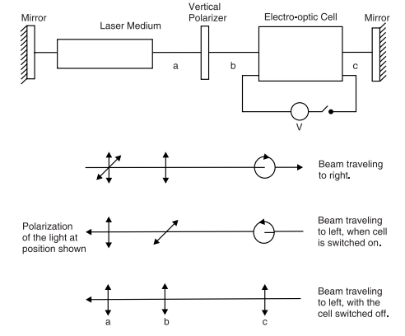
ELECTRO-OPTIC SHUTTER
serve as a voltage-controlled gate ⇒rapidly switches the cavity from a high loss to a low loss condition.
It consists of a crystal that becomes double refracting (birefringent) when an electric field is applied across the crystal.
Applied voltage transforms the Electro-Optic crystal into a quarter-wave plate
When the voltage is ON;
Crystal become double refracting
Light is not allowed to pass through the polarizer ; Q reduced to low value;
Cavity switched off
When the voltage is OFF;
Double refraction is absent
Light freely travels in both directions and return to laser rod to be further amplified-Q regains its high value ;
Cavity is switched on

Slide 18
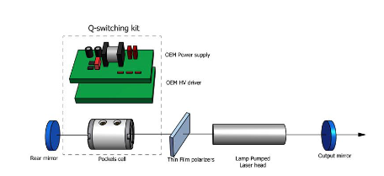


Q-switching is synchronized with pumping mechanism such that the voltage applied to the crystal drops to zero at the time when the population inversion in the laser medium attain its peak value.
Two types of Electro-Optic Shutters
Kerr Cell
Pockels Cell(Preferred -need lower voltage to produce desired effect)

Slide 19
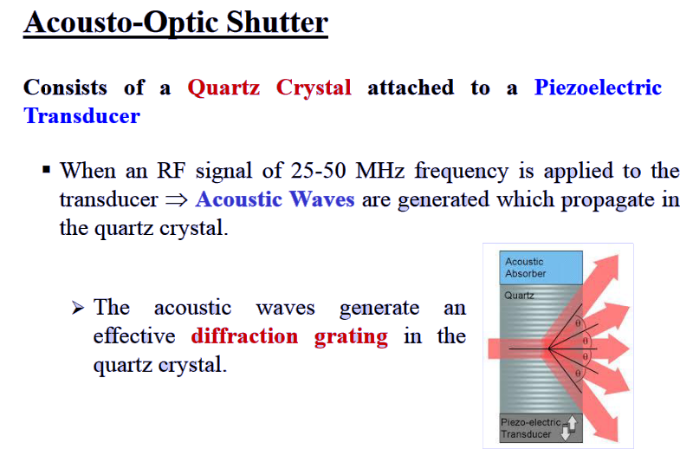

Slide 20
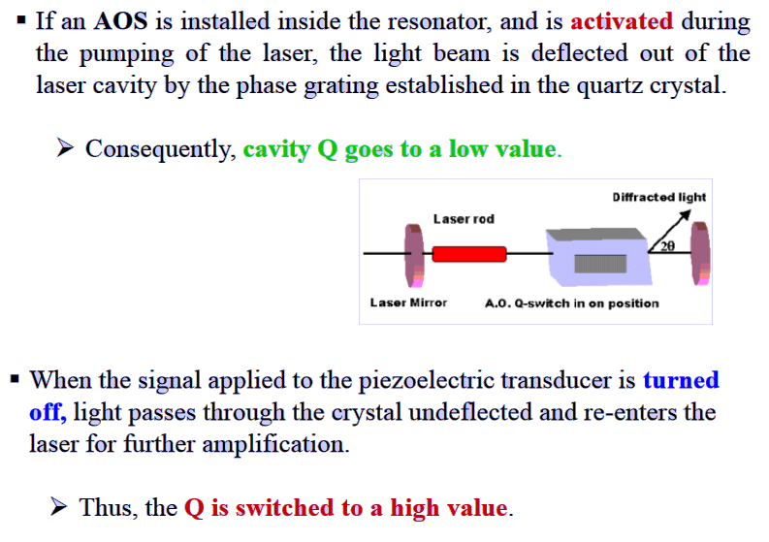


Slide 21
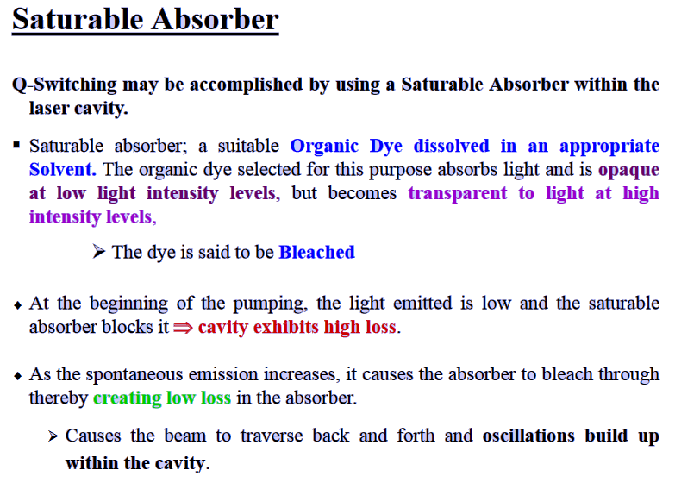

Slide 22
